Slide 1
Multiple Regression
Prof. Andy Field

Slide 2
Aims
Understand When To Use Multiple Regression.
Understand the multiple regression equation and what the betas represent.
Understand Different Methods of Regression
Hierarchical
Stepwise
Forced Entry
Understand How to do a Multiple Regression on IBM SPSS
Understand how to Interpret multiple regression.
Understand the Assumptions of Multiple Regression and how to test them

Slide 3
What is Multiple Regression?
Linear Regression is a model to predict the value of one variable from another.
Multiple Regression is a natural extension of this model:
We use it to predict values of an outcome from several predictors.
It is a hypothetical model of the relationship between several variables.

Slide 4
Regression: An Example
A record company boss was interested in predicting album sales from advertising.
Data
200 different album releases
Outcome variable:
Sales (CDs and Downloads) in the week after release
Predictor variables
The amount (in £s) spent promoting the album before release (see last lecture)
Number of plays on the radio (new variable)

Slide 5
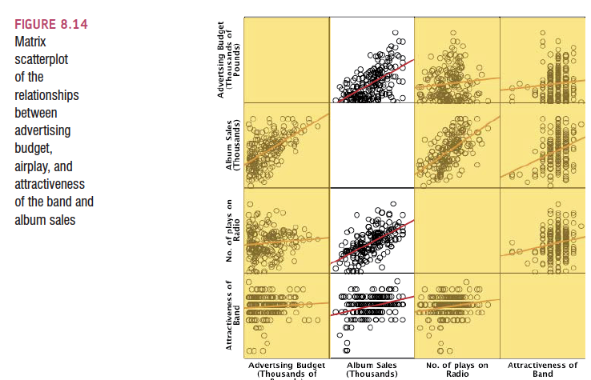

Slide 6
Multiple Regression as an Equation
With multiple regression the relationship is described using a variation of the equation of a straight line.
Notes:
A similar equation can be derived in which each predictor variable has its own coefficient, and the outcome variable is predicted from a combination of all the variables multiplied by their respective coefficients plus a residual term (see equation above).
Y is the outcome variable, β₁ is the coefficient of the first predictor (X₁), β₂ is the coefficient of the second predictor (X₂), β_{n} is the coefficient of the n^{th} predictor (X_{n}), and ε_{i} is the difference between the predicted and the observed value of Y for the i^{th} subject. In this case, the model fitted is more complicated, but the basic principle is the same as simple regression. That is, we seek to find the linear combination of predictors that correlate maximally with the outcome variable.

Slide 7
b₀
b₀ is the intercept.
The intercept is the value of the Y variable when all Xs = 0.
This is the point at which the regression plane crosses the Y-axis (vertical).

Slide 8
Beta Values
b₁ is the regression coefficient for variable 1.
b₂ is the regression coefficient for variable 2.
b_{n} is the regression coefficient for n^{th} variable.

Slide 9
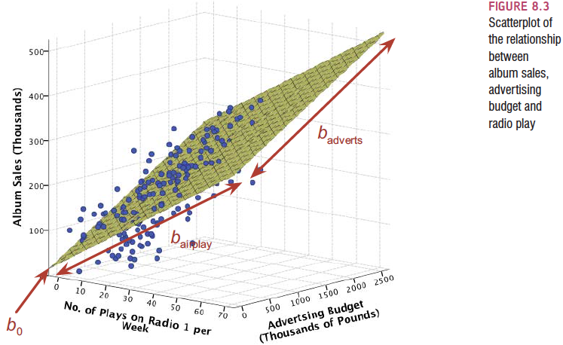
The Model with Two Predictors

Slide 10
Methods of Regression
Hierarchical:
Experimenter decides the order in which variables are entered into the model.
Forced Entry:
All predictors are entered simultaneously.
Stepwise:
Predictors are selected using their semi-partial correlation with the outcome.

Slide 11
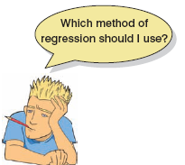

Slide 12
Hierarchical Regression
Known predictors (based on past research) are entered into the regression model first.
New predictors are then entered in a separate step/block.
Experimenter makes the decisions.

Slide 13
Hierarchical Regression
It is the best method:
Based on theory testing.
You can see the unique predictive influence of a new variable on the outcome because known predictors are held constant in the model.
Bad Point:
Relies on the experimenter knowing what they’re doing!

Slide 14
Forced Entry Regression
All variables are entered into the model simultaneously.
The results obtained depend on the variables entered into the model.
It is important, therefore, to have good theoretical reasons for including a particular variable.

Slide 15
Stepwise Regression I
Variables are entered into the model based on mathematical criteria.
Computer selects variables in steps.
Step 1
SPSS looks for the predictor that can explain the most variance in the outcome variable.

Slide 16
Stepwise Regression II
Step 2:
Having selected the 1st predictor, a second one is chosen from the remaining predictors.
The semi-partial correlation is used as a criterion for selection.

Slide 17
Semi-Partial Correlation
Partial correlation:
measures the relationship between two variables, controlling for the effect that a third variable has on them both.
A semi-partial correlation:
Measures the relationship between two variables controlling for the effect that a third variable has on only one of the others.

Slide 18
Semi-Partial Correlation in Regression
The semi-partial correlation
Measures the relationship between a predictor and the outcome, controlling for the relationship between that predictor and any others already in the model.
It measures the unique contribution of a predictor to explaining the variance of the outcome.

Slide 19
Problems with Stepwise Methods
Rely on a mathematical criterion.
Variable selection may depend upon only slight differences in the Semi-partial correlation.
These slight numerical differences can lead to major theoretical differences.
Should be used only for exploration

Slide 20
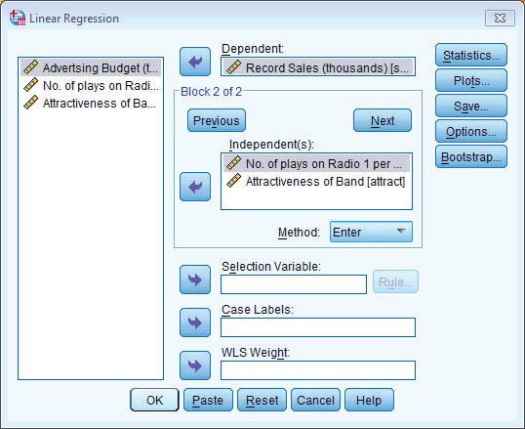
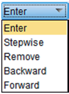
Doing Multiple Regression

Slide 21
Doing Multiple Regression

Slide 22
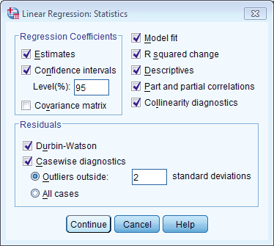
Regression Statistics

Slide 23
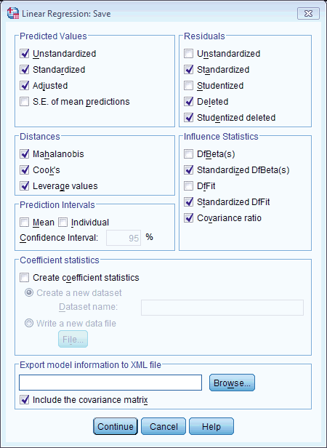
Regression Diagnostics

Slide 24
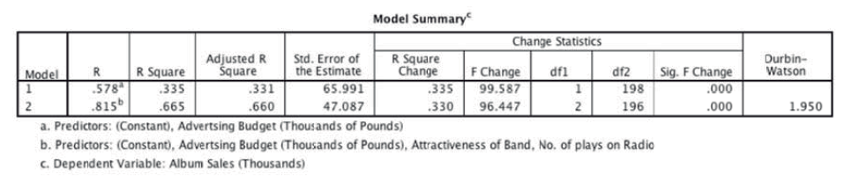
Output: Model Summary

Slide 25
R and R²
R
The correlation between the observed values of the outcome, and the values predicted by the model.
R²
Yhe proportion of variance accounted for by the model.
Adj. R²
An estimate of R² in the population (shrinkage).

Slide 26
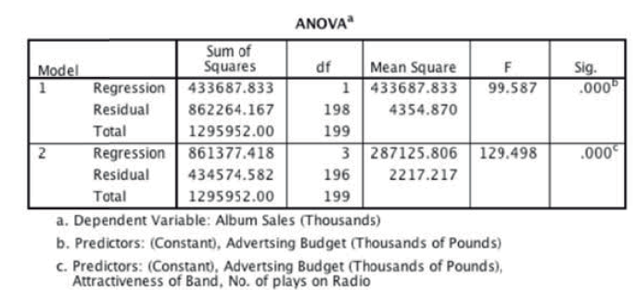
Output: ANOVA

Slide 27
Analysis of Variance: ANOVA
The F-test
looks at whether the variance explained by the model (SS_{M}) is significantly greater than the error within the model (SS_{R}).
It tells us whether using the regression model is significantly better at predicting values of the outcome than using the mean.

Slide 28
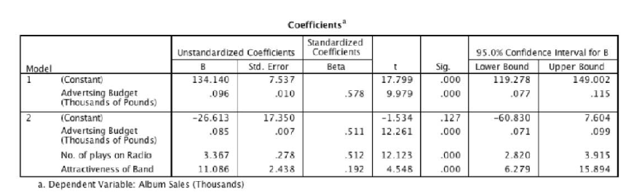
Output: betas

Slide 29
How to Interpret Beta Values
Beta values:
the change in the outcome associated with a unit change in the predictor.
Standardised beta values:
tell us the same but expressed as standard deviations.

Slide 30
Beta Values
b₁= 0.087.
So, as advertising increases by £1, album sales increase by 0.087 units.
b₂= 3589.
So, each time (per week) a song is played on the radio its sales increase by 3589 units.

Slide 31
Constructing a Model

Slide 32
Standardised Beta Values
β₁= 0.523
As advertising increases by 1 standard deviation, album sales increase by 0.523 of a standard deviation.
β₂= 0.546
When the number of plays on the radio increases by 1 SD its sales increase by 0.546 standard deviations.

Slide 33
Interpreting Standardised Betas
As advertising increases by £485,655, album sales increase by 0.523 × 80,699 = 42,206.
If the number of plays on the radio per week increases by 12, album sales increase by 0.546 × 80,699 = 44,062.

Slide 34
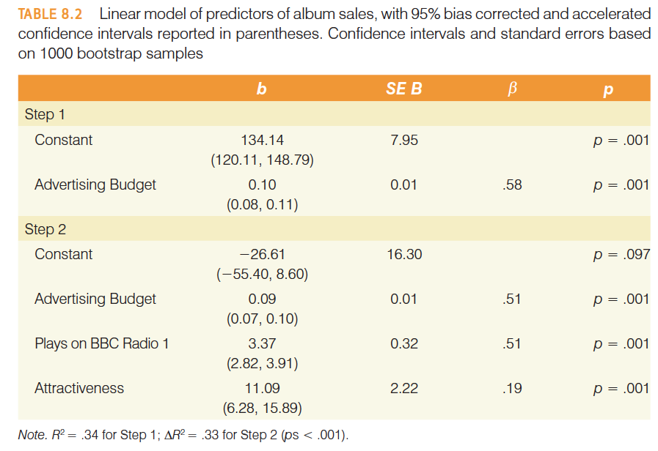
Reporting the Model

Slide 35

How well does the Model fit the data?
There are two ways to assess the accuracy of the model in the sample:
Residual Statistics
Standardized Residuals
Influential cases
Cook’s distance

Slide 36
Standardized Residuals
In an average sample, 95% of standardized residuals should lie between ± 2.
99% of standardized residuals should lie between ± 2.5.
Outliers
Any case for which the absolute value of the standardized residual is 3 or more, is likely to be an outlier.

Slide 37
Cook’s Distance
Measures the influence of a single case on the model as a whole.
Weisberg (1982):
Absolute values greater than 1 may be cause for concern.

Slide 38
Generalization
When we run regression, we hope to be able to generalize the sample model to the entire population.
To do this, several assumptions must be met.
Violating these assumptions stops us generalizing conclusions to our target population.

Slide 39
Straightforward Assumptions
Variable Type:
Outcome must be continuous
Predictors can be continuous or dichotomous.
Non-Zero Variance:
Predictors must not have zero variance.
Linearity:
The relationship we model is, in reality, linear.
Independence:
All values of the outcome should come from a different person.

Slide 40
The More Tricky Assumptions
No Multicollinearity:
Predictors must not be highly correlated.
Homoscedasticity:
For each value of the predictors the variance of the error term should be constant.
Independent Errors:
For any pair of observations, the error terms should be uncorrelated.
Normally-distributed Errors

Slide 41
Multicollinearity
Multicollinearity exists if predictors are highly correlated.
This assumption can be checked with collinearity diagnostics.

Slide 42
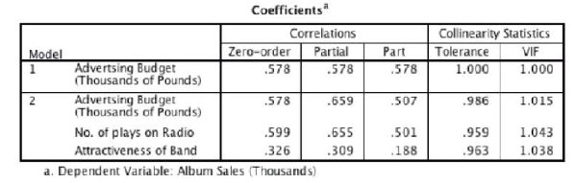
Tolerance should be more than 0.2 (Menard, 1995)
VIF should be less than 10 (Myers, 1990)

Slide 43
Checking Assumptions about Errors
Homoscedacity/Independence of Errors:
Plot ZRESID against ZPRED.
Normality of Errors:
Normal probability plot.

Slide 44
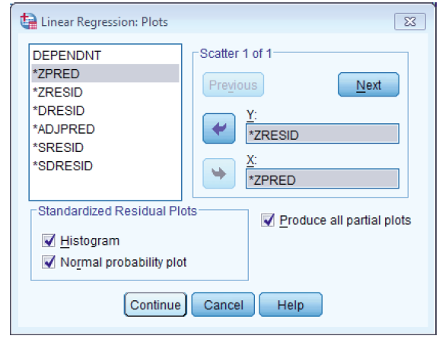
Regression Plots

Slide 45
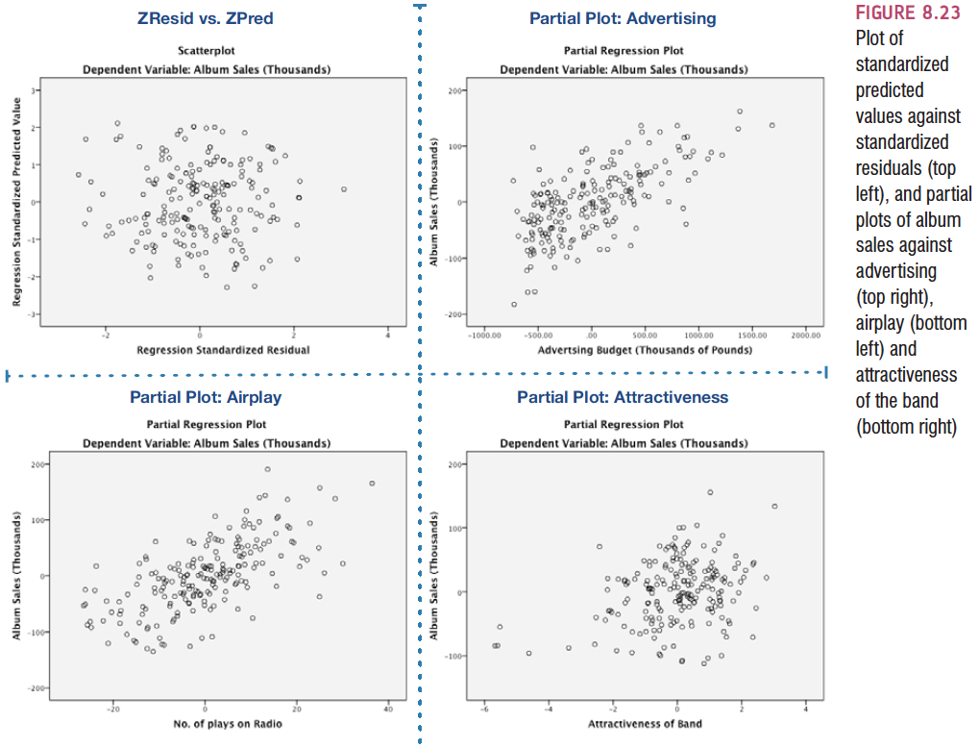
Homoscedasticity: ZRESID vs. ZPRED

Slide 46
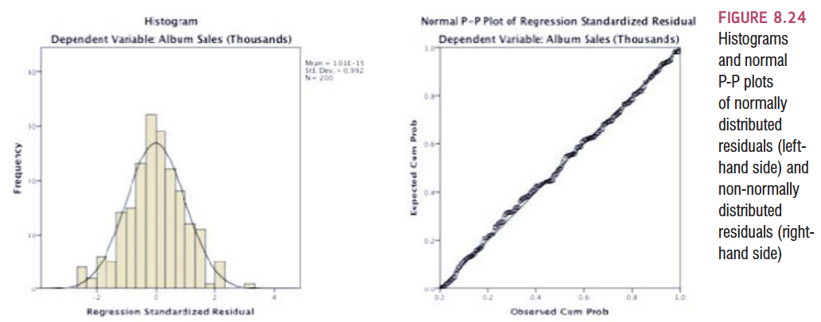
Normality of Errors: Histograms and P-P plots

